Slide 1
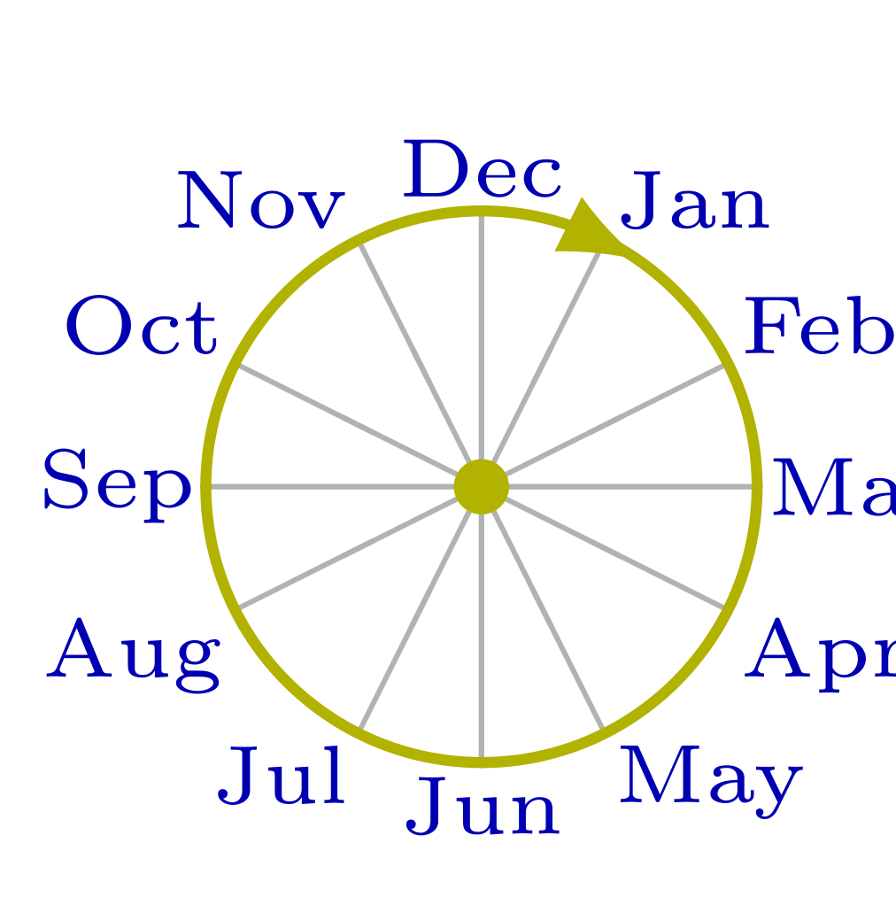
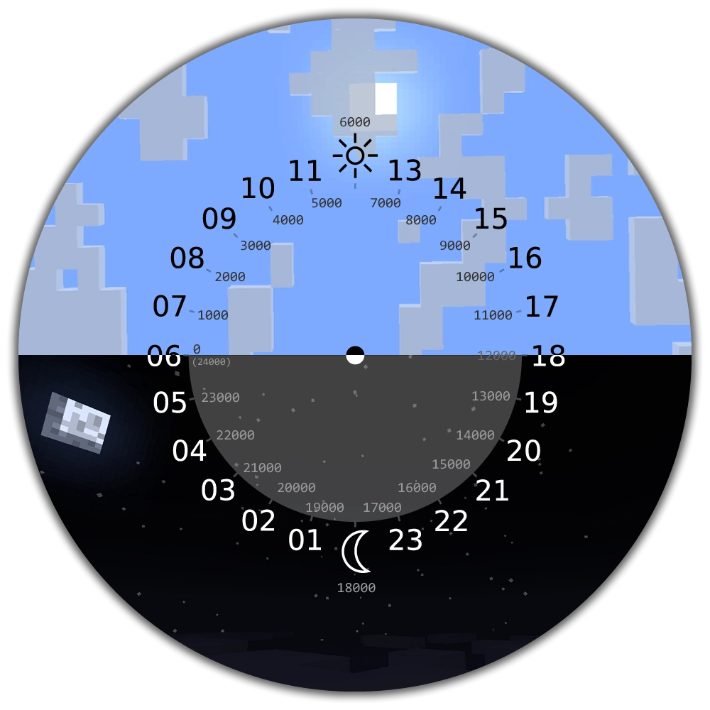
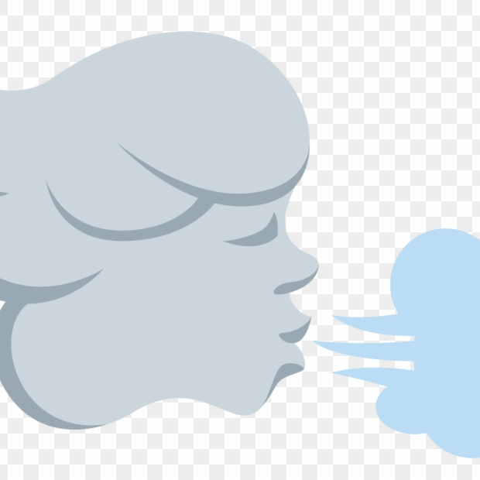
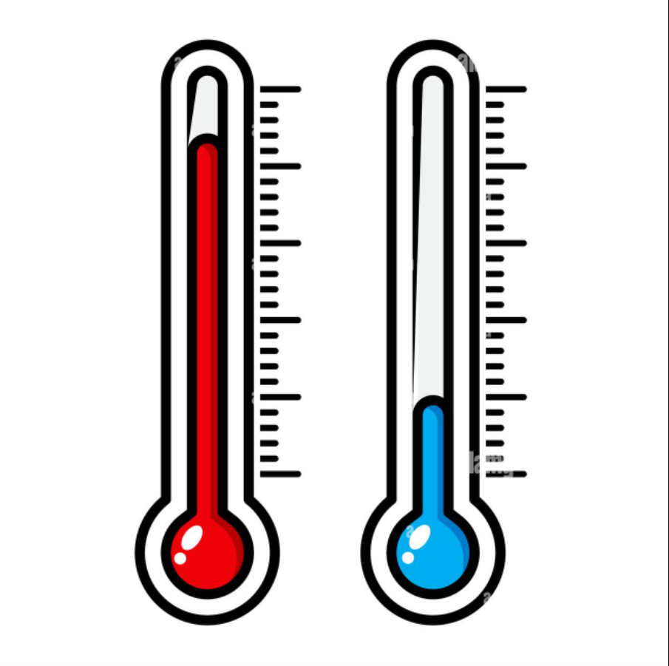
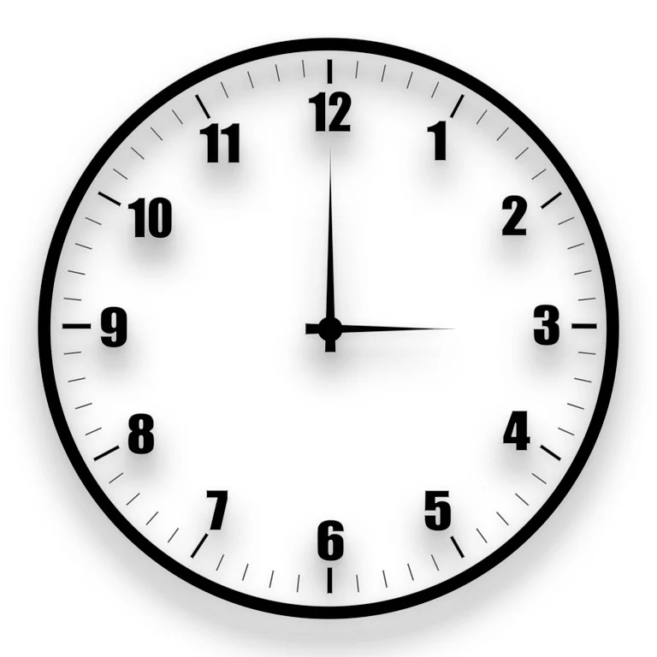

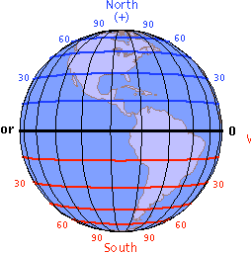
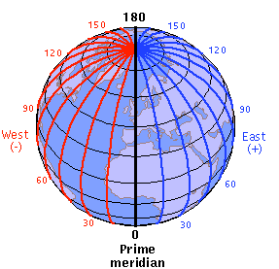

Flight Delay
Under-stand
Delay peaks from June to August, during the summer break. This might be due to an increase of flights or the hurricane season.
The particular day of the month doesn’t seem to have any real effect on the Fight Delay time. This needs to be combined with the month to make sense.
Wind speed around 2~4 m/s have the highest occurrences of Flight Delay, but the correlation is not strong.
Temperature from 15 to 25 Celsius has the highest delays. Like Wind speed, this might ne due to that there are simply more flight around that Temperature.
Month
Day
Wind Speed
Temp
Flight Delay
Flight delay can be a major downside for taking commercial aviation. It is of paramount importance to understand what might cause a flight delay in order to make better predictions ahead of time.
Clouds
Latitude
Longitude
Depart Time
If the Wind Speed and the Clouds are both high, there might be a higher chance of flight delay.
Delay happens the most around 32°N, in the southern part, where we have California, Arizona, Texas, Georgia, and Florida.
Delay happens the most around 80°W in the east coast, where we have New York, North Carolina, Virginia, Georgia, and Florida.
Delay happens most likely in the afternoon around 4pm(16:00). This is especially true for the east coast.

